Slide 1

Relief Net
Providing food, shelter and other services to low-income families and individuals who are barely above the poverty line
Team Sink
Sangit Gaire, Kobe Leverett, Diana Avila, Puru Saluja

Slide 2
The Issue
The focus on low-income families and individuals who are just above the poverty line. They face housing instability and food insecurity, but are not eligible for government assistance from programs like SNAP or TANF.
Information with regards to housing aid, food banks in that area is overly spread out and difficult to find.
With this in mind, many people who are currently in college are unaware that they’ll qualify for community resources that help them personally or pay for university.
Notes:
The "ALICE population" refers to Asset Limited, Income Constrained, Employed households—a growing demographic of workers who are above the Federal Poverty Level but cannot afford basic necessities like housing, food, and childcare. In 2023, 29% of US households, or 38 million households, were ALICE. They are living paycheck by paycheck and or often make decisions on payments like rent or food. They don’t have savings to fall back to if anything unexpected happened.

Slide 3
Competing Our Product
For Example: findhelp.org
It links people with local resources such as food, housing, medical care and education.
Now onto the limitations:
The UI that has too many options to review
Contains limited customization options.

Slide 4
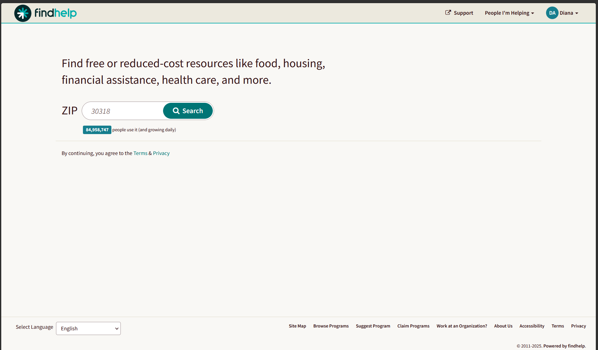
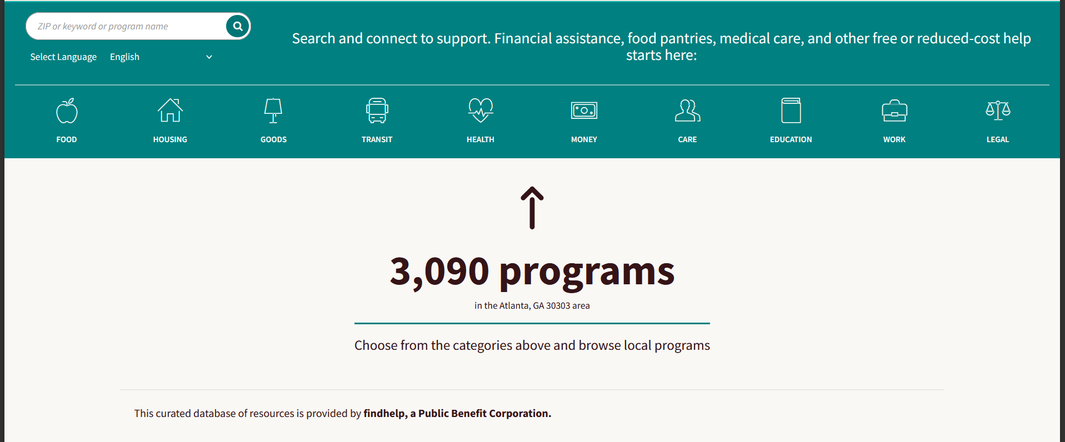
Examples:

Slide 5
Our Innovative Approach Towards This Issue
Creating a simple database driven system that directly links people to the resources that they’re eligible to.
Develop an UI that is simple and easy for the user to navigate.
Outreach to neighborhood services that involve food banks, housing assistance, places of worship like Churches, and other charitable organizations.
User profiles will have the ability to track and manage resources.
Even support for several languages (This is a beta phase so right now it’s only going to support English)
Notes:
As previously mentioned it’s designed for those who are barely above the poverty line including struggling students in college.

Slide 6
Who This Will Cater To/Benefit
Households who earn just over the poverty line.
College students who are enrolled in a university and upcoming college students who come from low income families.
Disadvantaged groups and immigrants who may not be aware of the local assistance that’s available to them.
People affected by circumstances who need immediate help (for example: emergency funds)

Slide 7
The Set Of Things That’ll Be Featured
User profiles: Location, income, household size, and others will all be saved into the database.
Eligibility Matching: Recommend only resources with users income/family size range.
Resource Finder: Applying the tool to search and filter by type (food, housing, non profit aid) through the database.
Saved Resources: Tied into your bookmarks for later use.
When additional programs or resources arise, notifications will be sent out to inform users of this.

Slide 8
The Possibilities Beyond The LLM
An application that specifically helps low income families and individuals for a general resource finder website that they will soon have access to for financial means that they’re struggling with.
LLM can provide general advice but can not maintain personalized user data over time.
It’ll incorporate eligibility logic back into the database (income, household size, location)
It’ll help preserve and adjust according to the user profile that’s implemented.
Link direct connections to neighborhood groups that are difficult for AI to create.
Notes:
Can your app be generated simply by prompting an LLM/agent? If so, what features should be added or what more difficult problem can you solve? - Last slide

Slide 9
Team Sink - Relief Net
THANK YOU !!!
Your comments and feedback would be highly appreciated !!!

